Slide 1
Chapter 8 sequential logic design practices
emphasis：
Counter:
counter composed of flip-flops and MSI counters, sequence generator
Shift register:
data shift function, ring counter, Johnson counter, sequence generator and detector

Slide 2
exercises
8.13, 8.14, 8.16(starting with state 00001)
8.26, 8.35, 8.38, 8.55
8.57, 8.58,

Slide 3
8.1 documentation standards
In logic block, input is on the right, output is on the left.
input
…
…
output
PR
…
…
…
…
…
…
CLK
CLR
Edge-triggered
Pulse-triggered
…
…
C

Slide 4
8.2 latches and flip-flops
1. SSI latches and flip-flops(figure 8-3)
74×74 — dual D f-fs
74×109 — dual J-K’ f-fs
74×375 — quad D latch
2. Switch debouncing
eliminate bouncing that occurs when the mechanical switch is on and off.
3. Bus-holder
避免三态输出总线上长期无信号而由噪声、干扰等产生较大电流而损坏器件的问题。

Slide 5
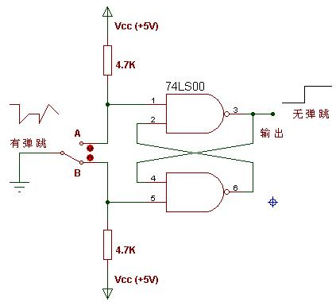
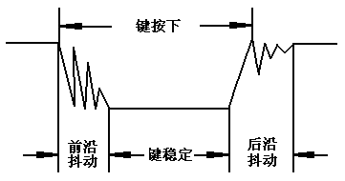
Switch debouncing
A usual switch debouncer
Some switch, button
S_L
当机械触点断开、闭合时,电压信号会抖动。抖动时间的长短由按键的机械特性决定,一般为5ms～10ms。
R_L
离开B，未到A
碰到A
R_L
S_L
Q

Slide 6
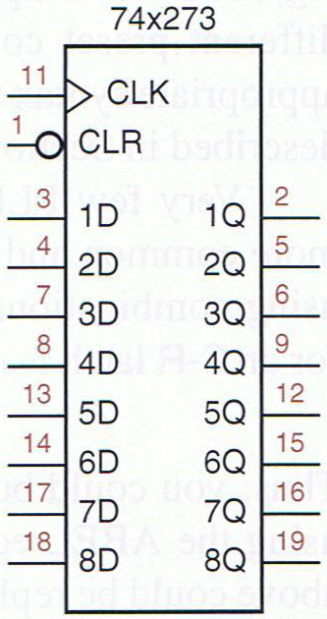
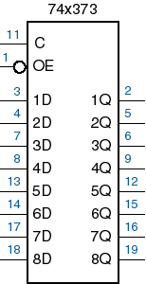
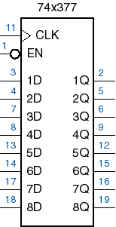
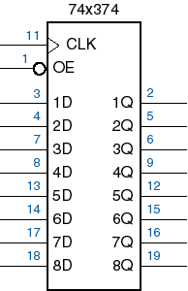
3. Multibit registers and latches
Collection of two or more D f-fs with a common clock input .
Cab be used to store a multiple-bit data.
with tri-state output
latch with tri-state output

Slide 7
PLDs
16V8 (20 Pins)
can have 16 inputs (max) and/or 8 outputs (marcrocells)
has 32 inputs to each of the AND gates (product terms)
20V8 (24 pins)
can have 20 inputs (max) and/or 8 outputs (marcrocells)
has 40 inputs to each of the AND gates (product terms)
22V10 (24 pins)
can have 22 inputs and/or 10 outputs (max)
has 44 inputs to each of the AND gates
It will be slower and will more wasted silicon space
Solution? Use CPLDs

Slide 8
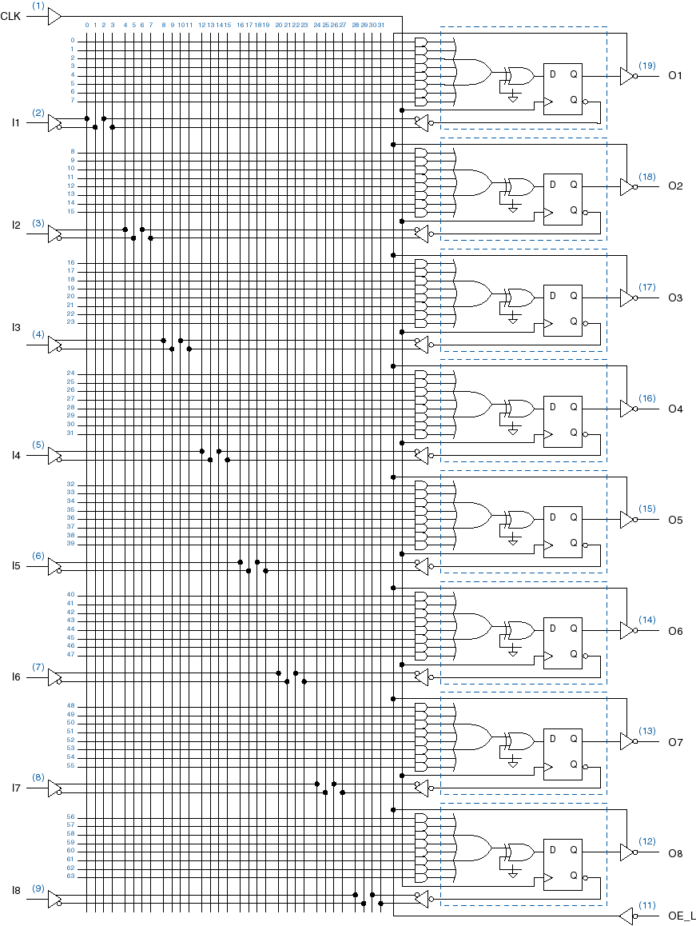
The OR gates
GAL16V8
Each output is programmable as combinational or registered
Also has programmable output polarity
AND Plane
XOR gates to
make inverting or
non-inverting buffer

Slide 9
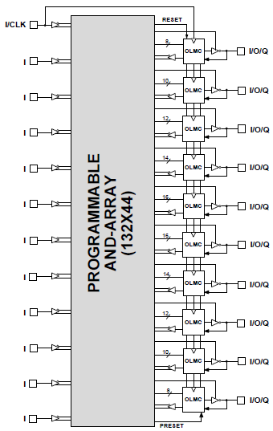
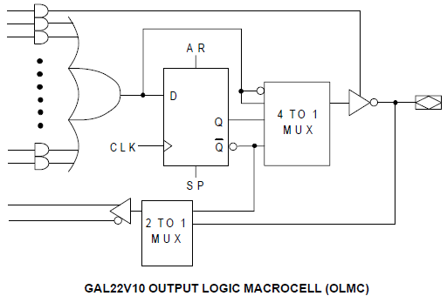
S0
S1
GAL22V10

Slide 10
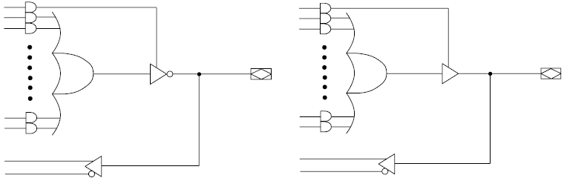
可实现时序逻辑
Active low S1S0=00
Active high S1S0=01
可实现组合逻辑
Active low S1S0=10
Active high S1S0=11

Slide 11
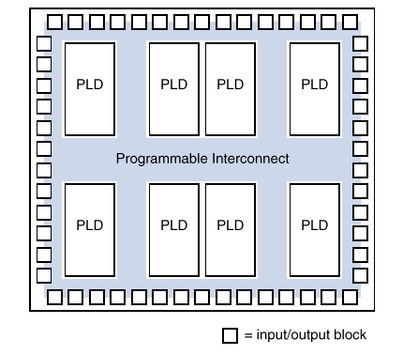
A General CPLD structure
A collection of PLDs on a single chip with
Programmble interconnects

Slide 12
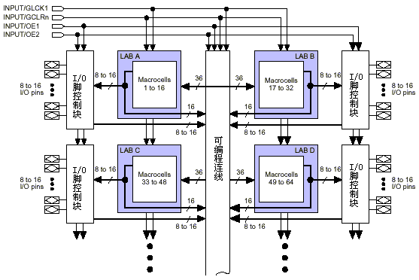
Product-term CPLD structure
PIA
(Programmable Interconnection Array)
LAB
(Logic Array Block)
I/O
Control
Block
MAX7000

Slide 13
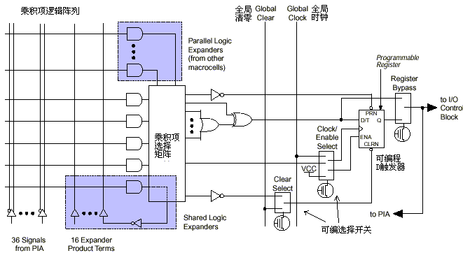
Macrocell structure

Slide 14
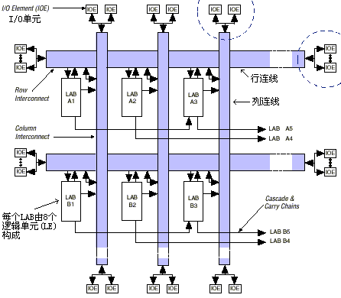
FPGA structure
Altera’s FLEX/ACEX

Slide 15
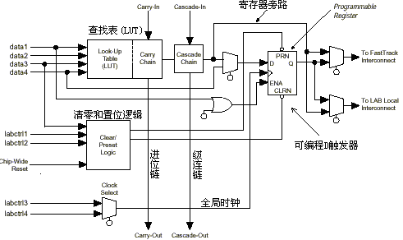
Macrocell structure

Slide 16
8.4 counters
Any sequential circuit whose state diagram is a single cycle.
Transition of successive state is unconditional.
Modulus — the number of states in the cycle
S1
n
Q[0..n-1]
Sm
S2
clock
…
Modulo-m counter
(m states → n=
flip-flops)
Sj
…
S3

Slide 17
General types of electronic counters
Classify in counting sequence
up counters, which count in ascending binary order
down counters, which count in descending binary order
Classify in counter circuit
Asynchronous (ripple) counter
Synchronous counter
Shift-Register Counters
Ring counter
Johnson counter
Application: counter, timer, frequency-division, sequence-generator, ……

Slide 18
1、ripple counters
Basic unit:
modulo-2 counter
1
Q
0
1
CLK
T
Q
1
CLK
Q

Slide 19
1、ripple counters
行波计数器、
串行计数器
（是异步计数的）
(fig8-24)
4-bit binary Counter output
Q0
(LSB)
Q1
Q2
Q3
(MSB)
Q
Q
Q
Q
CLK
T
Q
T
Q
T
Q
T
Q
CLK
Q0
Q1
Q2
Q3
CLK signal has propagation delay .
(counting carry information ripples from Q0 to Q3)

Slide 20
4-bit binary counter’s state diagram
0000
0001
0010
0011
0100
0101
0110
0111
1111
1110
1101
1100
1011
1010
1001
1000
It’s a up counter (or increased mode), and has 2⁴ states.
n-bit binary counter → has n flip-flops
→2^{n} states

Slide 21
Issue 1：how to make a down counter by T f-fs？
Issue 2：how to make the ripple counter by using D and J-K f-fs？(as homework, 4-bit)
--------------------------------------------------------------------------Also be acted as a digital frequency divider (divided-by-2^{n})
CLK
Q0
divide-by-2
Q1
divide-by-4
Q2
divide-by-8
Q3
divide-by-16

Slide 22
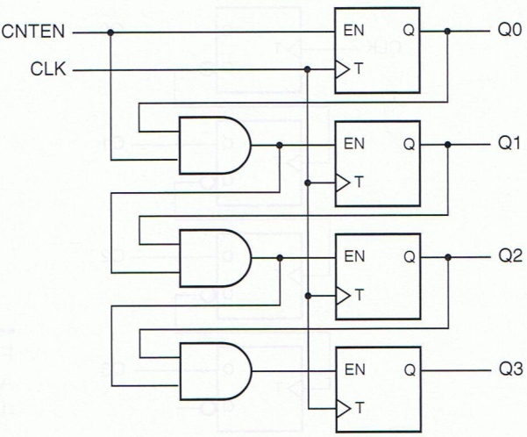
2、 Synchronous counters
All flip-flops change their states at the same triggering time of a common CLK signal.
EN0
transition equations： Qi*= ENi·Qi’+ENi’·Qi
(LSB)
EN1
Working features： EN signal propagates serially.
EN0=CNTEN
EN1=Q0·CNTEN
EN2=Q1·EN1
EN3=Q2·EN2
EN2
EN3
(MSB)
synchronous counter with serial enable signal
教材fig8-25

Slide 23
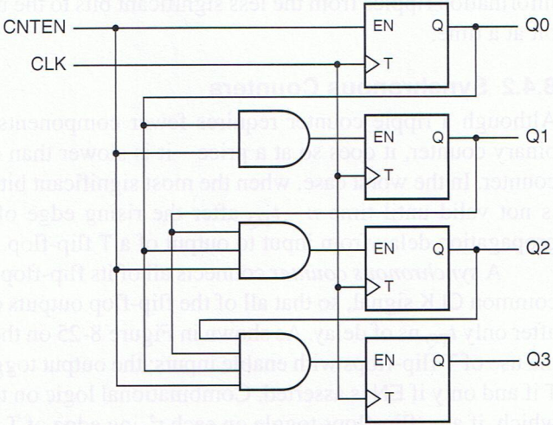
synchronous counter with parallel enable signal
EN0
(LSB)
CNTEN signal controls the f-fs simultaneously ;
the fastest binary counters structure.
EN1
EN2
教材fig8-26
EN3
(MSB)
Judge this circuit’s counting sequence (up or down)?

Slide 24
binary synchronous counter design with D flip-flops
Exp1: design a 3-bit binary synchronous down counter ,counter output Q2(msb),Q1,Q0。
the functional table：
Q2 | Q1 | Q0 | Q2* | Q1* | Q0*
0 | 0 | 0 | 1 | 1 | 1
0 | 0 | 1 | 0 | 0 | 0
0 | 1 | 0 | 0 | 0 | 1
0 | 1 | 1 | 0 | 1 | 0
1 | 0 | 0 | 0 | 1 | 1
1 | 0 | 1 | 1 | 0 | 0
1 | 1 | 0 | 1 | 0 | 1
1 | 1 | 1 | 1 | 1 | 0
Q2 Q1 Q0
111
110
101
100
000
001
010
011

Slide 25
excitation table of the counter
Q2 | Q1 | Q0 | Q2* | Q1* | Q0* | D2 | D1 | D0 | J2K2 | J1K1 | J0K0
0 | 0 | 0 | 1 | 1 | 1 | 1 | 1 | 1 | 1d | 1d | 1d
0 | 0 | 1 | 0 | 0 | 0 | 0 | 0 | 0 | 0d | 0d | d1
0 | 1 | 0 | 0 | 0 | 1 | 0 | 0 | 1 | 0d | d1 | 1d
0 | 1 | 1 | 0 | 1 | 0 | 0 | 1 | 0 | 0d | d0 | d1
1 | 0 | 0 | 0 | 1 | 1 | 0 | 1 | 1 | d1 | 1d | 1d
1 | 0 | 1 | 1 | 0 | 0 | 1 | 0 | 0 | d0 | 0d | d1
1 | 1 | 0 | 1 | 0 | 1 | 1 | 0 | 1 | d0 | d1 | 1d
1 | 1 | 1 | 1 | 1 | 0 | 1 | 1 | 0 | d0 | d0 | d1
excitation equations：
D2=Q2Q1+Q2Q0+Q2’Q1’Q0’
D1=Q1Q0+Q1’Q0’
D0=Q0’
……

Slide 26
design synchronous counter with module less than 2^{n}
module of the counter m<2^{n}，the disposition of unused state：
minimal risk
minimal cost，need to verify the unused state that assures the circuit can be returned to the normal
Need to verify the counter’ s self-correction
Exp2：design a modulo-6 counter，it count the clock ticks by using 0,2, 4, 3,5,7，synthesis by D flip-flop in minimal cost.

Slide 27
Exp.2 a module-6 counter
Q2 | Q1 | Q0 | Q2* | Q1* | Q0*
0 | 0 | 0 | 0 | 1 | 0
0 | 1 | 0 | 1 | 0 | 0
1 | 0 | 0 | 0 | 1 | 1
0 | 1 | 1 | 1 | 0 | 1
1 | 0 | 1 | 1 | 1 | 1
1 | 1 | 1 | 0 | 0 | 0
0 | 0 | 1 | d | d | d
1 | 1 | 0 | d | d | d
D2=Q1’ ·Q0+Q2’ ·Q1
D1=Q1’
D0=Q2’ ·Q0+Q2·Q1’
Verify the unused state:
Q2Q1Q0=001, Q2*Q1*Q0*=111
Q2Q1Q0=110, Q2*Q1*Q0*=000
These two next states can turn back into the counter’s cycle
counter
Unused
state

Slide 28
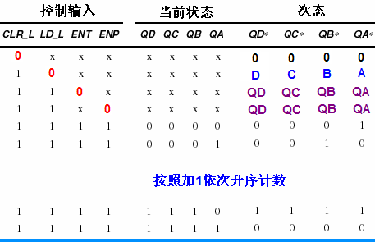
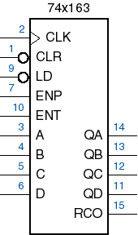
3、MSI counters and applications
synchronous 4-bit binary counter 74×163
clear
loading
hold
ENT=ENP=CLR_L=LD_L=1，counting
RCO（ripple carry output）:when Q_{D}Q_{C}Q_{B}Q_{A}=1111 ，and ENT=1，RCO=1。

Slide 29
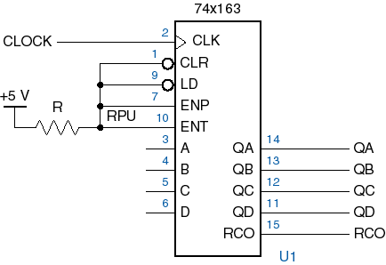
working in free-running mode (modulo-16 counter)
74×163 is fully synchronous, its outputs change only on the rising edge of clock.
LSB
MSB
Counting from 0 to 15

Slide 30
using 74×163 in m<16 mode counter
Exp：modulo-11 counter
method 1：feedback-clear mode(反馈清零) — count the first m binary numbers from 0000.
key：when counting to the number (m-1), the counter return to 0000 .
so, need a feedback circuit F，and when Q_{D}Q_{C}Q_{B}Q_{A}=1010, make CLR_L asserted.
74×163
QA
Q0
QB
Q1
CLR
QC
Q2
QD
Q3
F=?
CLR_L

Slide 31
Q3 | Q2 | Q1 | Q0 | CLR_L
0 | 0 | 0 | 0 | 1
0 | 0 | 0 | 1 | 1
0 | 0 | 1 | 0 | 1
0 | 0 | 1 | 1 | 1
0 | 1 | 0 | 0 | 1
0 | 1 | 0 | 1 | 1
0 | 1 | 1 | 0 | 1
0 | 1 | 1 | 1 | 1
1 | 0 | 0 | 0 | 1
1 | 0 | 0 | 1 | 1
1 | 0 | 1 | 0 | 0
CLR_L=(Q3·Q2’ ·Q1·Q0’)’
CLR_L=(Q3·Q1·)’
74×163
QA
Q0
QB
Q1
CLR
QC
Q2
QD
Q3
F
CLR_L
For 1011~1111, the CLR_L is deal with don’t care .

Slide 32
verify the unused state
Unused states 1011~1111:
0001
0010
1011
0000
…
1100
1101
1110
1111
1010
0110
…
CLR_L=(Q3·Q1)’
…
1000
It can run automatically.

Slide 33
using 74×163 in m<16 mode counter
Method 2：feedback-load mode(反馈置数)—count the last m states or arbitrary m continual states between 0000 and 1111.
key：make LD_L asserted when counting to the ending state, and the initial state is loaded.
①if the ending state is 1111，use the RCO output to reload the initial state.
Initial state=ending state – counting modulo + 1
=15-11+1=5
So all the counting state is 0101~1111.

Slide 34
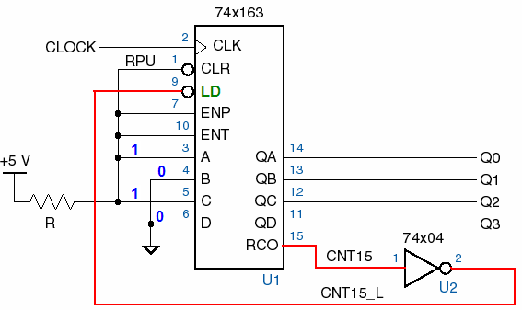
reference circuit of feedback-load

Slide 35
②if the ending state isn’t 1111, then we need to set an initial state and an ending state.
initial state = ending state – modulo + 1
or, ending state = initial state + modulo - 1
like，knowing the ending state is 13，so the initial state = 13-11+1=3
or, knowing the initial state is 2，so the ending state =2+11-1=12
circuit design：be similar to feedback-clear mode, but its output need to be connected to the LD_L of 74×163.

Slide 36
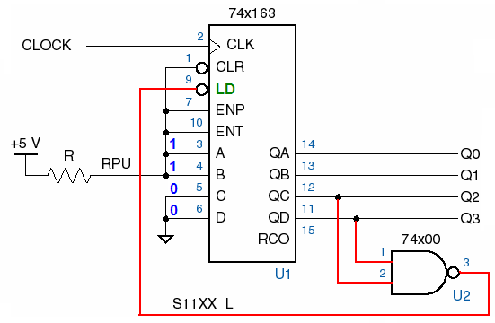
reference circuit of feedback-load
counting from 3 to 13(0011~1101)

Slide 37
74×163 cascading application
if the counting modulo >16，multiple 74×163 could be cascaded.
key：counting nesting(嵌套)
n pieces of 74×163 →maximum modulo 16^{n}。
connecting lower grade counter’s RCO output to next higher grade counter’s EN signal.

Slide 38
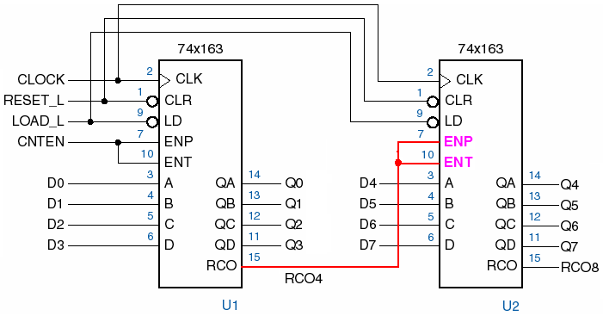
Modulo-256 free-run counter

Slide 39
16<modulo<256 counters
Exp，a modulo-125 counter
methods：
feedback-clear — 0~124；
feedback-reload — 131~255，or arbitrary two numbers whose difference is 124 between 0 and 255.

Slide 40
Circuit for “feedback-clear — 0~124”
5V
U1
U2
D4
3
A
QA
14
D0
R2
3
A
QA
14
5V
D1
QB
13
D5
4
B
QB
13
D2
1k
4
B
12
D6
5
C
QC
12
D3
5
C
QC
D7
R1
6
D
QD
11
6
D
QD
11
7
ENP
RCO
15
7
ENP
ENT
rco1
10
ENT
RCO
15
1k
10
9
LOAD
9
LOAD
1
CLR
1
CLR
clock
2
CLK
2
CLK
74HC163N_6V
74HC163N_6V
U3
74HC30

Slide 41
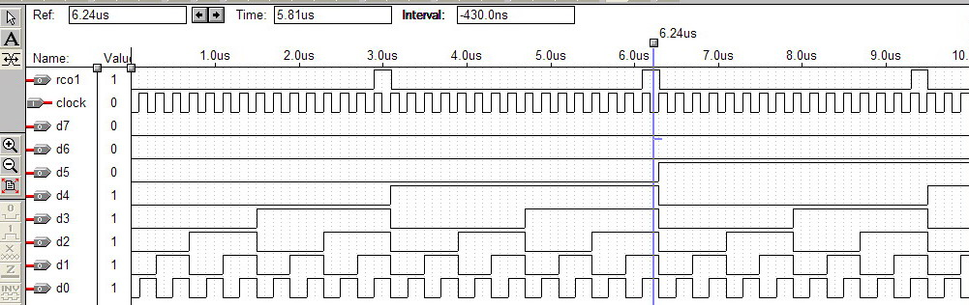
Waveform for modulo-125 counter

Slide 42
From counter to timer
Modulo-6
Modulo-10
BCD-7 segment decoder
n
displayer
clock
carry
T=1s
Modulo-60
555多谐振荡器
或
与非门构成的双稳电路
74LS48
或
74LS49
共阴型LED
74×162

Slide 43
An n×m modulus counter
Modulo n
Modulo m
EN
Q0
EN
Q0
…
QL
…
QH
Qi
Qj
RCO
RCO
clock
RCO
Please implement the 6×10 modulus counter with 74x162
3
A
QA
14
74xx162: synchronous BCD decade counter synchronous reset and loading
4
B
QB
13
5
C
QC
12
6
D
11
7
QD
10
ENP
ENT
RCO
15
9
LOAD
1
CLR
2
CLK
2018/6/6
43
74xx162

Slide 44
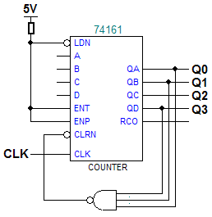
Other counters
74×161，asynchronous clear 4-bit binary counter.
asynchronous clear ：if CLR_L=0，Q_{D}Q_{C}Q_{B}Q_{A} output 0000 immediately .
other function is as the same as 74×163. use 74×161 to modulo-11 in feedback-clear mode，count ending = 1011，
Counting N | Q₃Q₂Q₁Q₀
0 | 0000
1 | 0001
2 | 0010
3 | 0011
4 | 0100
5 | 0101
6 | 0110
7 | 0111
8 | 1000
9 | 1001
10 | 1010
11 | 1011

Slide 45
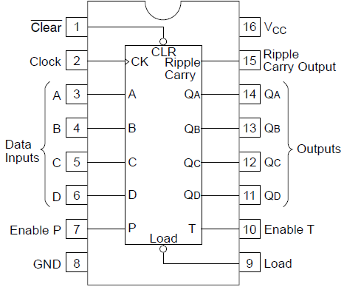
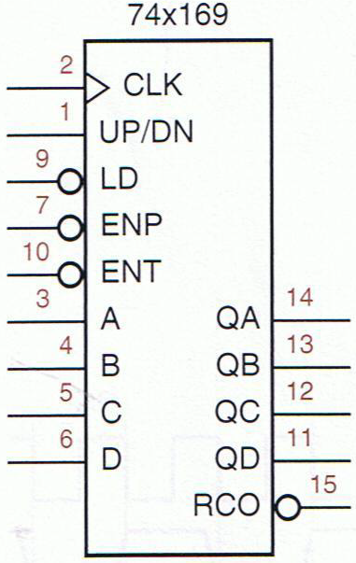
Other counters
decades counter
74×160（asynchronous clear）
74×162 (fully synchronous)
74×169 4-bt up/down counter
74x160/162

Slide 46
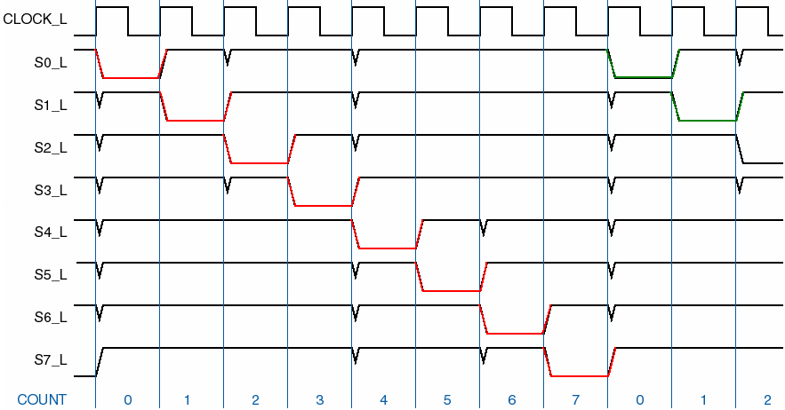
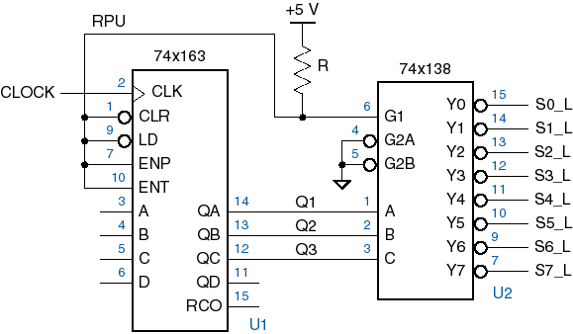
4、decoding binary-counter states
Combine a binary counter with a decoder to obtain a set of 1-out-of-m-coded signals.
Sequential pulse generator

Slide 47
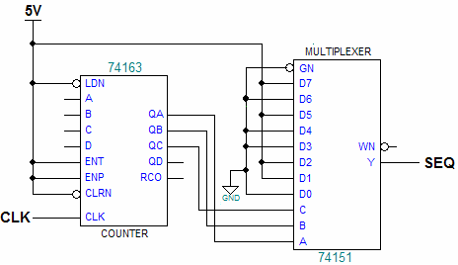
supplement：sequence generator
design a sequence-generator with 74×163 and 74×151
Exp：a “01100101” sequence-generator
A sequence generator composed of counter & MUX : if the counter is enable, at the each clock tick, circuit output every bit of the sequence.

Slide 48
design sequence-generator with D F-Fs
设计方法：顺序计数+组合电路
Exp: design a code generator which can output 011010 sequentially。
用顺序计数器的每个计数值产生一个码位。
D2 D1 D0
Q2Q1Q0 | Q2*Q1*Q0* | SEQ
000 | 001 | 0
001 | 010 | 1
010 | 011 | 1
011 | 100 | 0
100 | 101 | 1
101 | 000 | 0
110 | ddd | d
111 | ddd | d
000 0
001 1
010 1
101 0
100 1
011 0
110
111
100

Slide 49
circuit for sequence-generator in counter mode
U3A
4
U1A
U3D
D2
1PR
Q2
2
1D
1Q
5
74LS00D
74LS00D
U3B
3
1CLK
1Q
6
Q2'
74LS00D
1CLR
1
74LS74D
U3C
4
U1B
U5A
D1
1PR
Q1
2
1D
1Q
5
74LS00D
U4A
74LS00D
Q1'
3
1CLK
1Q
6
1CLR
74LS10D
1
74LS74D
4
U2A
D0
1PR
Q0
2
1D
1Q
5
clock
3
1Q
6
Q0'
1CLK
1CLR
1
74LS74D
U6A
SEQ
74LS32D

Slide 50
8.5 Shift Register
An n-bit register with a provision for shifting its stored data by one bit position at each tick of the clock.
serial-in, serial-out
Classified by structure：
serial-in, parallel-out
parallel-in, serial-out
parallel-in, parallel-out
Classified by shifting direction：
Shift-left
Shift-right

Slide 51
Shift direction
An n-bit number D_{n-1}D_{n-2}……D₁D₀ is stored in an n-bit shift register.
Shift left：shift from LSB to MSB
Shift right：shift from MSB to LSB
Qn-1
Qn-2
Q1
Q0
shift left
D_{n-2}
…
…
D₁
D₀
D_{new}
D_{n-1}
D_{n-2}
…
…
D₁
D₀
Qn-1
Qn-2
…
Q1
Q0
shift right
D_{new} | D_{n-1} | D_{n-2} | … | … | D₁

Slide 52
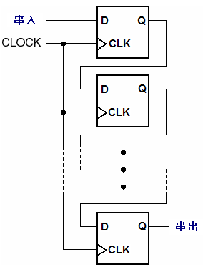
1、shift-register structure
（1）、serial-in, serial-out
t₀
t_{n}
input
output
n clock tick
After n clock ticks, an input bit appears at the serial output.
it can be used as a pulse-postponed circuit.

Slide 53
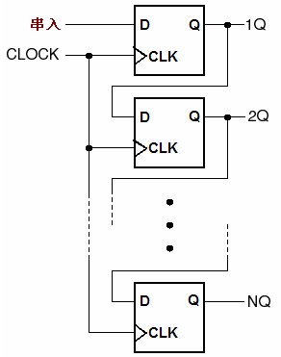
（2）、serial-in, parallel-out
serial in
serial-parallel conversion
并出
parallel out

Slide 54
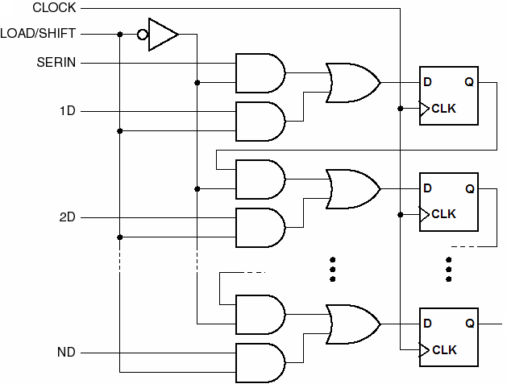
（3）、parallel-in, serial-out
0
0
1
1
load/shift=1，load data，Di=iD
load/shift=0，data shift，Di=Qi-1
D1
Q1
数据并入
U1
D2
U2
Dn
serial out

Slide 55
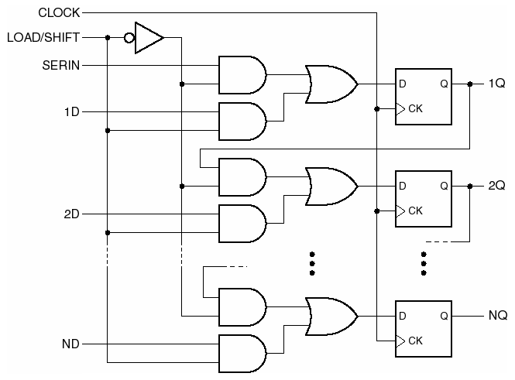
（4）、parallel-in, parallel-out

Slide 56
Detect the signal’s edge with shift register
Dout
Din
D
Q
Din
clock
clock
Dout
有时，为了避免边沿形状不好导致检测失误，会用2-3级移位寄存器。
Detect the posedge
Detect the negedge

Slide 57
Switch debouncing with shift register
IN
clock
OUT
?
这里输出0或者1，要视具体采集数据的瞬间而定，此处是假设为0

Slide 58
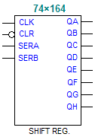
2、MSI shift register
74×164, serial-in, parallel-out with asynchronous clear input（CLR_L）.
shift direction
10
11
12
13
U1
3
4
5
6
MCU
QA
QB
QC
QD
QE
QF
QG
QH
74HC164
CLR
CLK
A
B
1
2
9
8
SERA·SERB
RXD
TXD

Slide 59
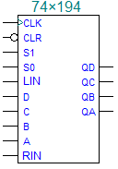
MSI shift register
74×194，4-bit bidirectional, parallel-in, parallel-out
Function input | Next state |  |  |  | function
S1S0 | QA* | QB* | QC* | QD*
00 | QA | QB | QC | QD | Hold
01 | RIN | QA | QB | QC | Shift right
10 | QB | QC | QD | LIN | Shift left
11 | A | B | C | D | load
Q0
Q1
Q2
Q3
注意：此处的左移（QD到QA）、右移（QA到QD）是针对该器件定义的，与数据单元的左/右移不同。
应用中，习惯性按照数据移位方向命名，即右移是从高到低，因而QA——Q3

Slide 60
3、application of shift register: serial/parallel conversion
source
destination
clock signal
control circuit
control circuit
synchronous signal
parallel-in data
parallel-out data
parallel-serial conversion
parallel-serial conversion
serial data

Slide 61
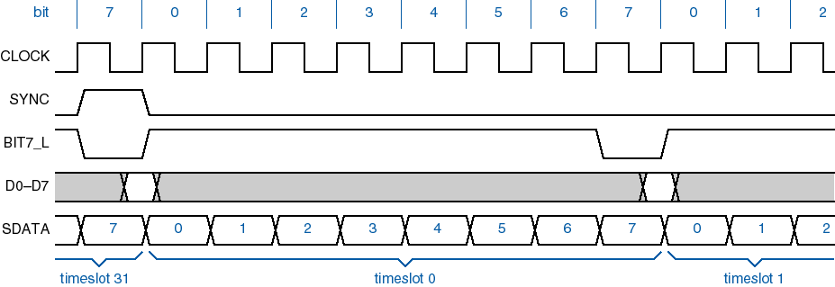
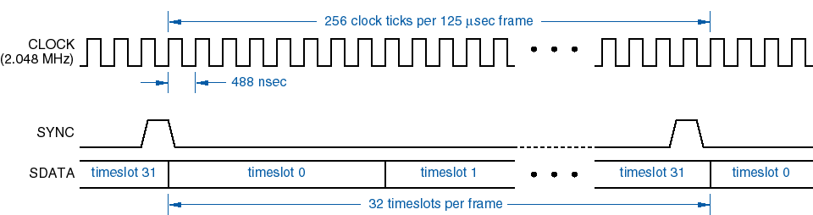
数字式程控交换机的时分多路复用系统。

Slide 62
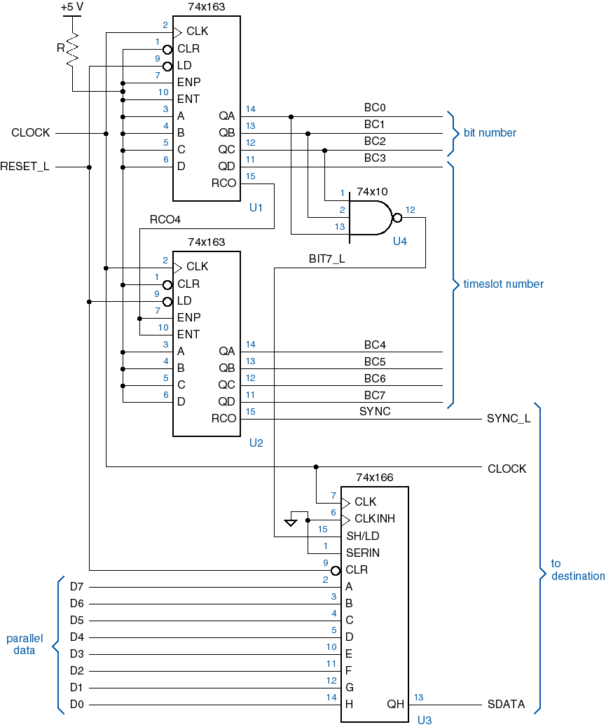

Slide 63
5、shift-register counters
be differ from the binary up or down counters.
ring counter
an n-bit shift register can be used to obtain a counter with n states.
Q0
Q1
Q2
Q3
4-bit ring counter
D
Q
D
Q
D
Q
D
Q
CLK
Q
CLK
Q
CLK
Q
CLK
Q
clock
Q0*=D0=Q3 Q1*=D1=Q0 Q2*=D2=Q1 Q3*=D3=Q2

Slide 64
ring counter
Q3Q2Q1Q0 | Q3*Q2*Q1*Q0*
0001 | 0010
0010 | 0100
0100 | 1000
1000 | 0001
initial state：Q₃Q₂Q₁Q₀=0001
Q0
Q1
Q2
Q3
D0
D
Q
D1
D
Q
D2
D
Q
D3
D
Q
CLK
Q
CLK
Q
CLK
Q
CLK
Q
clock
（D1）Q0
（D2）Q1
（D3）Q2
（D0）Q3

Slide 65
State diagram of ring counter
A single circle including 4 states could be used as a modulo-4 counter. (by using 4 F-Fs)
(是顺序脉冲发生器的一种)
0001
0010
0011
0110
0111
1110
1000
0100
1001
1100
1011
1101
normal cycle
0101
1010
1111
Not self-correcting
0000
Abnormal cycle

Slide 66
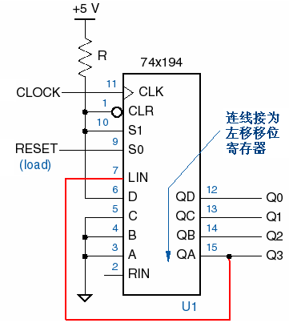
use MSI shift register to implement a ring counter
RESET=1，load ABCD=0001；
RESET=0，shift left
State:
Q3Q2Q1Q0
0001
0010
1000
0100

Slide 67
Self-correcting ring counter
D0
Not self-correcting
Q3Q2
Q1Q0
00
01
11
10
Modify the counting circle
00
0 | 0 | 1 | 1
0 | 0 | 1 | 1
0 | 0 | 1 | 1
0 | 0 | 1 | 1
0001
0010
0000
01
11
1000
0100
10
D0
0011
0110
0111
1110
Q3Q2
Q1Q0
00
01
11
10
00
1 | 0 | 0 | 1
0 | 0 | 0 | 0
0 | 0 | 0 | 0
0 | 0 | 0 | 0
1001
1100
01
1011
1101
11
0101
1010
10
1111
D0=Q2’ ·Q1’ ·Q0’

Slide 68
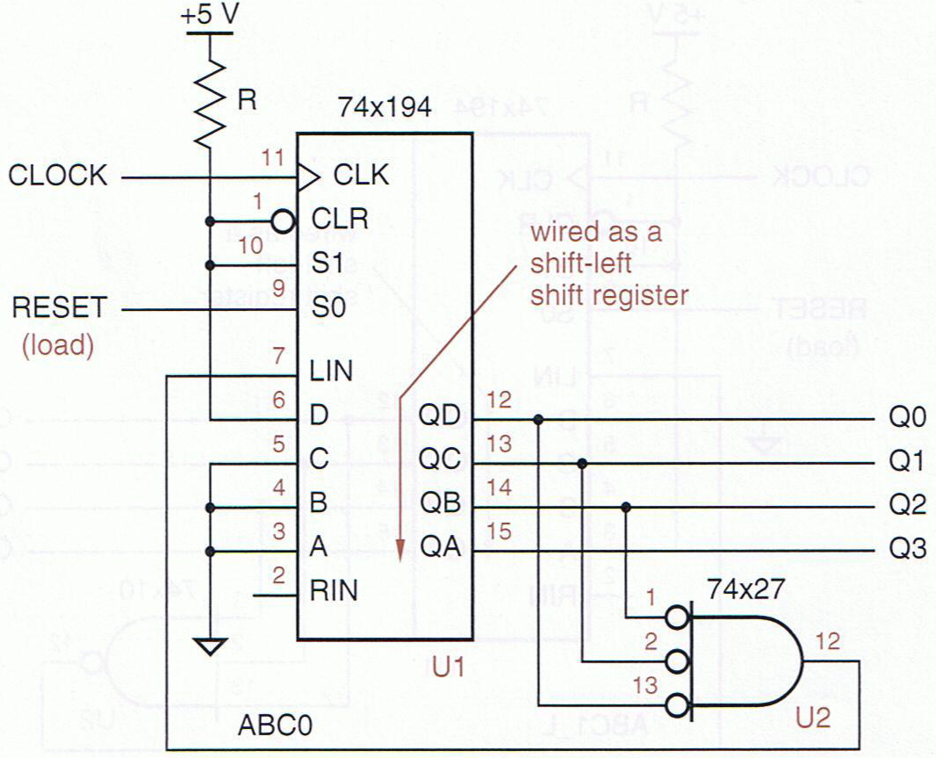
Self-correcting ring counter
Change the feedback circuit connected to D0.
将环形计数器的低三位经或非门连到LIN端构成校正电路，即LIN=Q2’ ·Q1’ ·Q0’。
So, it is a self-correcting ring counter.

Slide 69
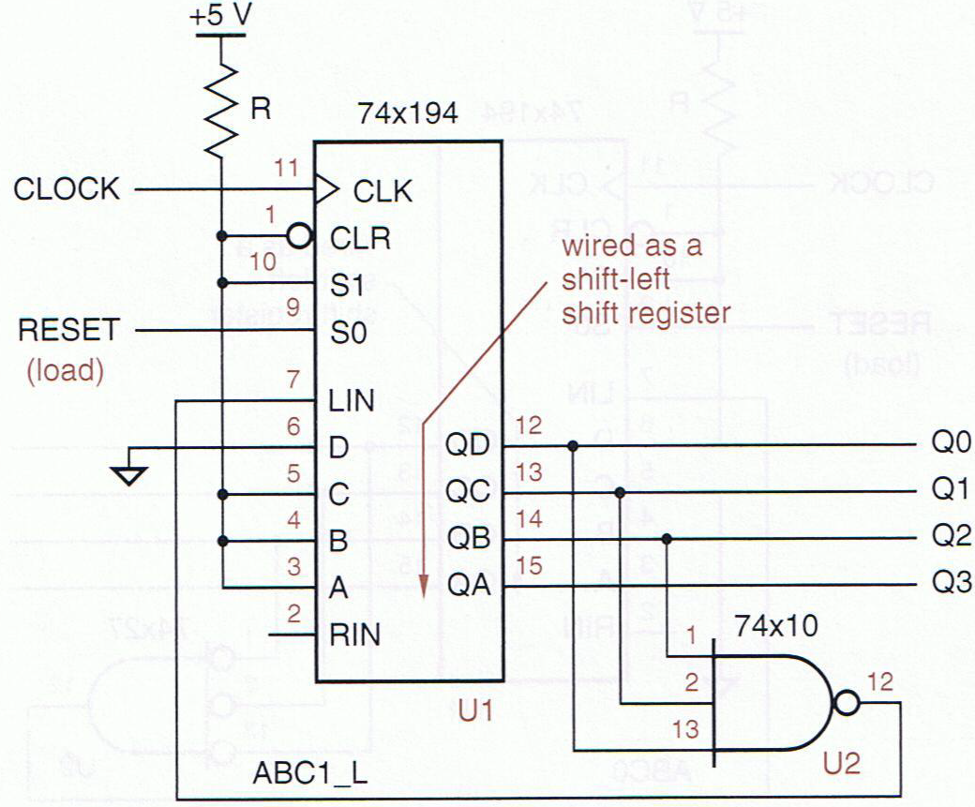
If the ring counter adopt active-low 1-out-of-n code, then the self-correcting circuit is a 3-input NAND gate which has Q0~Q3 input.
1110
1101
0111
1011

Slide 70
7、Johnson Counters (twisted-ring counter）
stucture
Q0
Q1
Q2
Q3
D0
PR
PR
PR
PR
D
Q
D
Q
D
Q
D
Q
CLK
Q
CLK
Q
CLK
Q
CLK
Q
CLR
CLR
CLR
CLR
CLK
Transition equation：
Q0*=D0=Q3’ Q1*=D1=Q0 Q2*=D2=Q1 Q3*=D3=Q2

Slide 71
State diagram of normal cycle
Set initial Q₃Q₂Q₁Q₀=0000，
An n-bit Johnson counter has 2n state. It could be used as a modulo-8 counter.
Q₃Q₂Q₁Q₀
0000
0001
0011
0111
1000
1100
1110
1111

Slide 72
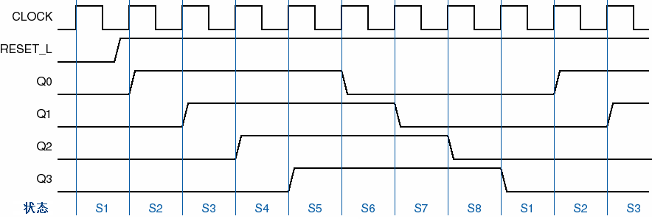
Timing diagram
Each Q_{i} output a pulse which has 8 times of the clock period and 50% duty cycle.
也可作为顺序脉冲发生器

Slide 73
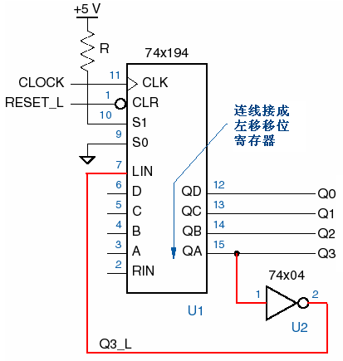
Johnson counter by using 74x194
RESET_L=0，clear
RESET_L=1，so S1S0=10 make the shift register shift left，Q3Q2Q1Q0：0000—0001—0011—……—1000。

Slide 74
Johnson counter state decoder
Johnson counter
decoder
Y0
state | Q3 | Q2 | Q1 | Q0 | decording
S1 | 0 | 0 | 0 | 0 | Q3’·Q0’
S2 | 0 | 0 | 0 | 1 | Q1’·Q0
S3 | 0 | 0 | 1 | 1 | Q2’·Q1
S4 | 0 | 1 | 1 | 1 | Q3’·Q2
S5 | 1 | 1 | 1 | 1 | Q3·Q0
S6 | 1 | 1 | 1 | 0 | Q1·Q0’
S7 | 1 | 1 | 0 | 0 | Q2·Q1’
S8 | 1 | 0 | 0 | 0 | Q3·Q2’
Y1
Y2
Q3
Y3
Q2
Y4
Q1
Y5
Y6
Q0
CLK
Y7
Each state can be decoded with a 2-input AND or NAND gate. The output are glitch free.

Slide 75
Q3 | Q2 | Q1 | Q0 | Y7 | Y6 | Y5 | Y4 | Y3 | Y2 | Y1 | Y0 | decording
0 | 0 | 0 | 0 | 0 | 0 | 0 | 0 | 0 | 0 | 0 | 1 | Q3’·Q0’
0 | 0 | 0 | 1 | 0 | 0 | 0 | 0 | 0 | 0 | 1 | 0 | Q1’·Q0
0 | 0 | 1 | 1 | 0 | 0 | 0 | 0 | 0 | 1 | 0 | 0 | Q2’·Q1
0 | 1 | 1 | 1 | 0 | 0 | 0 | 0 | 1 | 0 | 0 | 0 | Q3’·Q2
1 | 1 | 1 | 1 | 0 | 0 | 0 | 1 | 0 | 0 | 0 | 0 | Q3·Q0
1 | 1 | 1 | 0 | 0 | 0 | 1 | 0 | 0 | 0 | 0 | 0 | Q1·Q0’
1 | 1 | 0 | 0 | 0 | 1 | 0 | 0 | 0 | 0 | 0 | 0 | Q2·Q1’
1 | 0 | 0 | 0 | 1 | 0 | 0 | 0 | 0 | 0 | 0 | 0 | Q3·Q2’

Slide 76
Self-correcting Johnson counter
The other 8 unused state is abnormal cycle.
Neither normal cycle nor abnormal cycle is self-correcting.
0101
1011
0110
1101
Q₃Q₂Q₁Q₀
0010
1001
0100
1010

Slide 77
Self-correcting Johnson counter: feedback to load
When current state Q₃Q₂Q₁Q₀ is 0××0, the circuit loads 0001 as the next state.
0101
1011
0110
1101
0010
1001
0100
1010
0000
0001
0011
0111
1000
1100
1110
1111

Slide 78
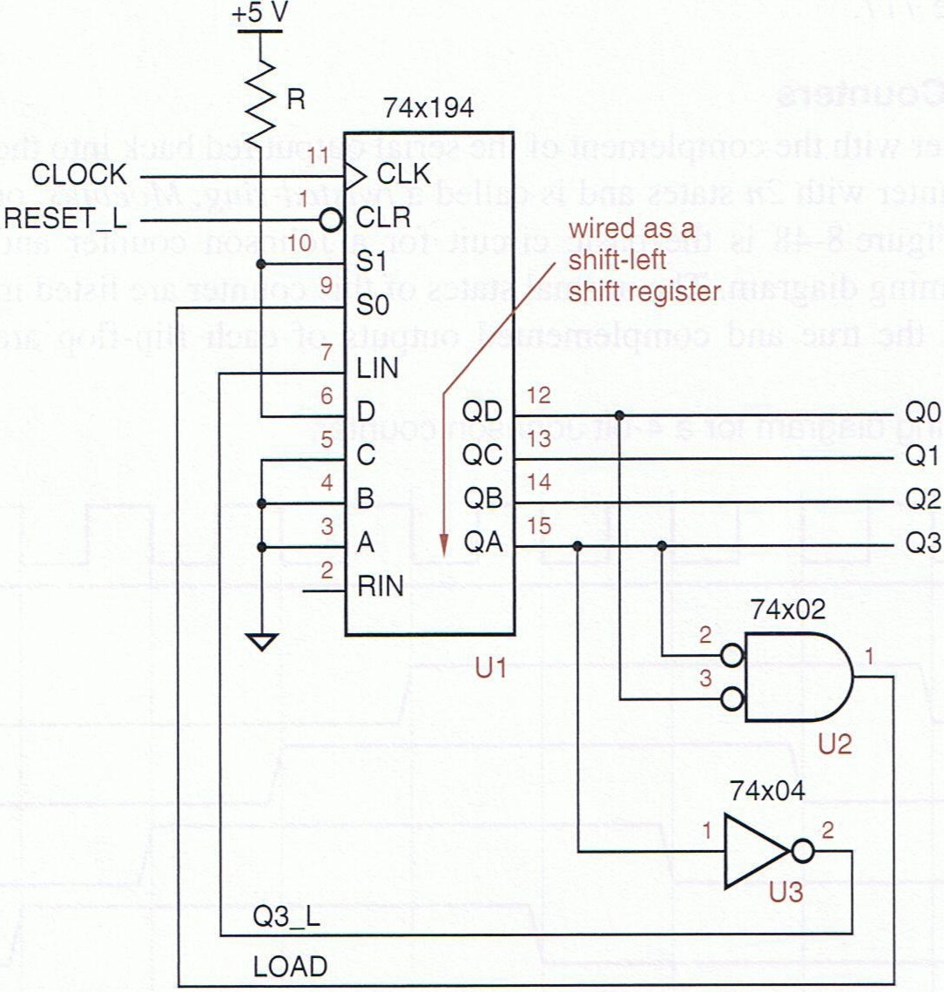
Self-correcting Johnson counter

Slide 79
Self-correcting Johnson counter 2:
Make some abnormal states turn into the normal cycle.
D0
0101
1011
0110
1101
Q3Q2
Q1Q0
1 | 0 | 0 | 0
1 | 1 | 0 | 1
1 | 1 | 0 | 1
1 | 0 | 0 | 0
0010
1001
0100
1010
0000
0001
0011
0111
D0=Q3’ ·Q2’+Q3’ ·Q0+Q2’ ·Q0
1000
1100
1110
1111
2018/6/6
79

Slide 80
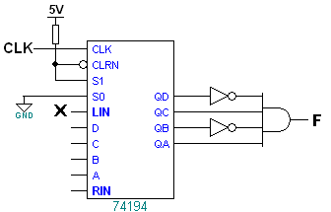
Applying shift register to sequence-detecting and sequence-generating
Exp1. A circuit output 1 when its serial input X gets continuous 1010, try to implement it with shift register。
Circuit 1.
0
1
detector
0
data shift left
1

Slide 81
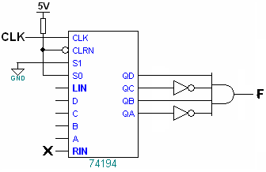
Applying shift register to sequence-detecting and sequence-generating
The same exp. with another implement circuit.
Circuit 2.
1
detector
0
1
0
data shift right

Slide 82
Supplement: Sequence generator
The structure of a sequence generator implementing with shift register.
序列输出F
1
out
1
n-bit Shift register
Next bit generator
n
current state
clk
通常，序列的长度即为电路的状态个数，按状态个数S确定触发器（状态变量）个数n，以连续的n位bit为一个状态，在所需生成的序列中按照依次移动1bit的顺序找出S个独立的状态。

Slide 83
Exp 2：a circuit output sequence 011010011010 … continuously, try to implement it with D flip-flops.
How to find all states?
……0 1 1 0 1 0 0 1 1 0 1 0……
The sequence is 6-bit long.
So need 6 states to generate each bit at least.
Q2 | Q1 | Q0 | Q2* | Q1* | Q0* | D0(F)
0 | 1 | 1 | 1 | 1 | 0 | 0
1 | 1 | 0 | 1 | 0 | 1 | 1
1 | 0 | 1 | 0 | 1 | 0 | 0
0 | 1 | 0 | 1 | 0 | 0 | 0
1 | 0 | 0 | 0 | 0 | 1 | 1
0 | 0 | 1 | 0 | 1 | 1 | 1
0 | 0 | 0 | d | d | d | d
1 | 1 | 1 | d | d | d | d
3-bit state variable → 3-bit shift register
D2=Q1
D1=Q0
D0=Q2·Q0’+Q2’·Q1’

Slide 84
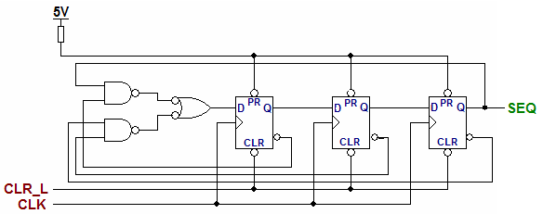
Judge whether the circuit is self-correcting or not：
Q2Q1Q0=000 → Q2*Q1*Q0*=001
Q2Q1Q0=111 → Q2*Q1*Q0*=110
It do goes into a valid state

Slide 85
Exp3. please generating a sequence 1001101011 with shift register.
Solution：use each current state to generate the next bit which is going to shift in.
A 10-bit sequence 1001101011
Q₃Q₂Q₁Q₀ | Q₃*Q₂*Q₁*Q₀* | D0
1001 | 0011 | 1
0011 | 0110 | 0
0110 | 1101 | 1
1101 | 1010 | 0
1010 | 0101 | 1
0101 | 1011 | 1
1011 | 0111 | 1
0111 | 1110 | 0
1110 | 1100 | 0
1100 | 1001 | 1
Set 10 states
Next bit
D0
Q
D1
Q
D2
Q
D3
Q

Slide 86

Exp 4
Design a FSM circuit, it generates a sequence 100110000011, and implement it with shift register
Solution:
110110000011
right
12 states , need 4bit shift register
12bit
?
?
1101
1011
0110
1100
1000
0000
0000
0001
1110
1111
0111
0011

Slide 87
Exp 4
Redefine the states: 110110000011
5-bits per a state, so
11011→10110→01100→11000→10000→00000
→00001→00011→00111→01111→11110→11101

Slide 88
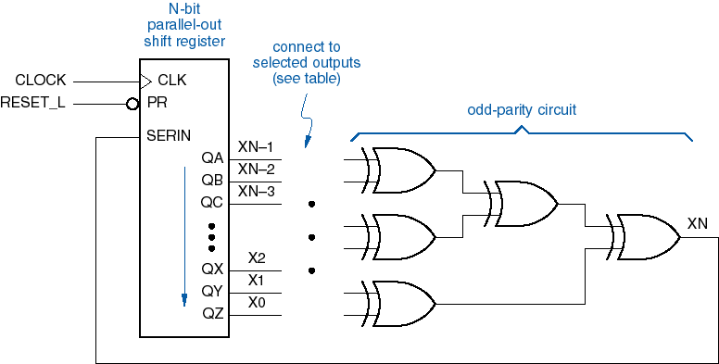
8、 linear feedback shift-register counters
ab. LFSR，normally be called maximum-length sequence generator. It can have 2^{n}-1 states (exclude all 0s state).
structure：

Slide 89
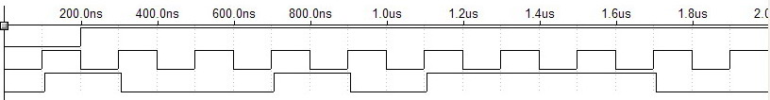
Also be called Pseudo-random pattern generator
Exp：n=3，the feed-back equation is X3=X1⊕X0
OUT
X2 | X1 | X0
1 | 0 | 0
0 | 1 | 0
1 | 0 | 1
1 | 1 | 0
1 | 1 | 1
0 | 1 | 1
0 | 0 | 1
X1
X3
X2
X0
D1
Q
D2
Q
D3
Q
CLOCK
Need a initial state (not all 0s)
CLK
OUT

Slide 90
8.6 iterative versus sequential circuits
the iterative circuit
PI₀
PI₁
PI_{n-1}
C₀
PI
C₁
PI
C₂
C_{n-1}
PI
C_{n}
…
CI
CO
CI
CO
CI
CO
PO
PO
PO
boundary input
PO₀
PO₁
PO_{n-1}
cascading input
cascading output

Slide 91
using flip-flops to store the cascading outputs at the end of each step
PI_{i}
CLK
C_{i}
PI
C_{i+1}
CI
CO
register
PO
PO_{i}

Slide 92
Serial comparator circuit
CMP
Y
EQO
X
D1
Q
EQI
CLOCK

Slide 93
Serial adder
X_{i}
1-bit
Full
adder
X
S
S_{i}
Y_{i}
Y
C_{i+1}
C_{i}
C_{i}
C_{o}
D
Q
CLK
clock

Slide 94
Serial parity circuit
D
Q
ODD
X_{i}
clock
CLK

Slide 95
8.7 synchronous design methodology
Synchronous system structure
store
Be handle at a higher level of abstraction
Data unit
Route(通路)
……
combine
Complex digital system
partition
process
start/stop
Control unit
testing conditions
……
Be designed as state machine
Deciding what to do next according to circumstance

Slide 96
8.8 impediments to synchronous design
Clock skew
Clock signal arrived at each flip-flop has different propagation
May cause metastable and produce an unpredictable output
Gating the clock
Suppress(压制) the clock input when it’s not supposed to be loaded

Slide 97
Summary for chapter 8
Counters
Modulo-m counters
Ripple counters
Up/down counter’s Structure, timing diagram
Synchronous counters
Structure, timing diagram
MSI counters
74x163, 74x161, 74x169……,
Function, enable input and RCO output
Free-running counter
Modulo-m counter, m<16^{n}(n=1, 2…)

Slide 98
Shift registers
Structure, function
Shift register counters
Ring counter
Johnson counter
Sequence detector
Applications of counters and shift registers
Sequence generator
Implement with counter and combinational circuit
Implement with shift registers

Slide 99
Class exercise
Design a modula-24 counter with 74*163 and some gates, please realize it by two types of circuit at least. (assume it starts at 00000)
Design a sequence generator which output 10001010, please synthesis this circuit with shift register.

Slide 100
课堂练习
2018/6/6
100
（1）设计一个序列信号检测器，当电路的输入端X收到连续的“1011”时，输出F为1，并且状态可以重叠。状态赋值采用Q_{m}Q_{m-1}…，按gray码序。
（2）设计一个5进制加/减计数器，当控制信号C=0，计数器按加1计数，当C=1，计数器按减1计数。用D触发器综合。

